Slide 1

Linux Device Driver Development for SHA256 Cryptographic Core in QEMU for RISC-V ISA
AREEB AHMED – 315868
s315868@studenti.polito.it
SHAHABUDDIN DANISH - 316538
s316538@studenti.polito.it
Group 08 (2023)
OPERATING SYSTEMS (04JEZOQ)
Prof. Stefano Di Carlo & Prof. Alessio Carpegna

Slide 2
Project Objectives and Execution Strategy
The objectives of the project included,
The development of a Linux device driver for SHA256 cryptographic core emulated in QEMU for RISC-V architecture.
The development of a laboratory experience to teach the project.
These objectives were divided into the following tasks,
Understanding and writing the SHA256 algorithm in C.
Modelling the SHA256 cryptocore and running a baremetal simulation with QEMU.
Developing the Linux Kernel Module for the cryptocore and relevant userspace applications.
Cross-compiling the LKM and userspace applications for RISC-V and emulating the complete system.
Creation of a detailed lab experience to teach the project.

Slide 3
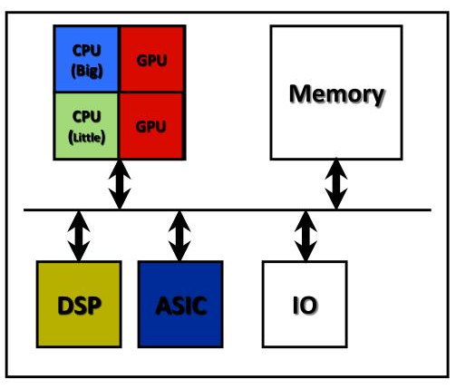
Heterogenous Computing Architectures
Heterogenous architecture involves a combination of CPUs, GPUs, ASICs and FPGAs.
Cryptographic cores are normally part of a heterogenous architecture.
ASIC implementation helps achieve superior performance, scalability and efficiency.
This architectural approach maximizes strengths of each component, as they focus on dedicated tasks.
Allows for parallel processing, resource sharing and deterministic processing.
Source: National Tsing Hua University

Slide 4
Cryptographic Accelerators & Algorithms
Cryptographic accelerators are specialized hardware devices designed specifically to execute cryptographic algorithms.
This specialization enables them to offer speed, efficiency and security.
Cryptographic accelerators can be implemented as ASICs, on FPGAs or as TPMs.
Cryptographic algorithms include Symmetric & Asymmetric Encryption or Hashing Functions.
These algorithms are useful for sensitive data protection, data integrity verification and authentication.

Slide 5
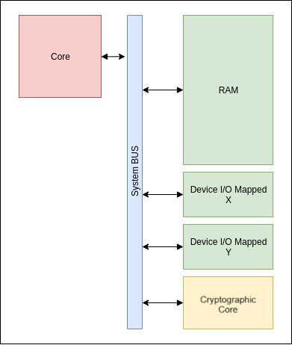
QEMU: Emulation & Virtualization
QEMU can perform full system emulation for various processor architectures.
Its entire hardware system emulation is independent from the host architecture or hardware.
Device emulation is handled through modular architecture, connecting virtualized devices to real ones.
It employs I/O virtualization techniques to optimize performance.
Its ability to emulate specialized and custom hardware allows for the ability to simulate heterogenous architectures.
Source: https://sebastienbourdelin.com/

Slide 6
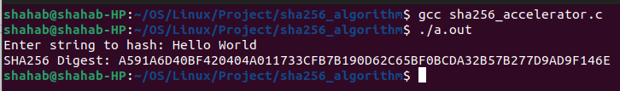
SHA256 Algorithm Implementation
Digest Size: SHA256 outputs a digest of 32 bytes, making it robust against collision attacks, where two different inputs produce the same output hash.
Input Size: SHA256 can process an input of any size, from zero bits up to a maximum that is less than 2^64 bits.
Block Size: The algorithm processes data in 512-bit blocks, using a series of bitwise operations, logical functions, and modular arithmetic.
The algorithm includes input padding and parsing, processing and then compression. The algorithm was programmed in C to understand it properly before creating the core.

Slide 7
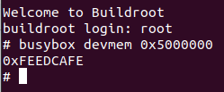
SHA256 Core Baremetal Simulation with QEMU
The crypto core was modelled for QEMU, describing the register map, core behaviour and read and write functions using the QEMU Object Model.
QEMU was configured and built for RISC-V architecture together with the modelled core.
A Buildroot system was setup up with the same RISC-V configuration with Linux which was run on top of the QEMU emulator.
The cryptocore was tested without any firmware by directly reading the memory-mapped addresses using BusyBox in buildroot.
The emulated device performed correctly without any driver when the ID register was read.

Slide 8
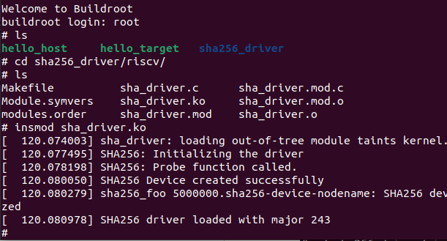
Driver Development & Cross-compilation
Drivers abstract away hardware and create a simpler interface to interact with a device.
The Virtual File System is important for this framework as when the device is made available as a file, the VFS connects the functions to the driver.
Linux recognizes character, block and network devices and drivers for them.
The driver also provides devices identification through major and minor numbers.
The device driver for the SHA256 core was cross-compiled through the Buildroot cross-compiler toolchain.
It was mounted on the rootfs of the system and then accessed from inside simulation.

Slide 9
Driver Development & Cross-compilation
Drivers abstract away hardware and create a simpler interface to interact with a device.
The Virtual File System is important for this framework as when the device is made available as a file, the VFS connects the functions to the driver.
Linux recognizes character, block and network devices and drivers for them.
The driver also provides devices identification through major and minor numbers.
The device driver for the SHA256 core was cross-compiled through the Buildroot cross-compiler toolchain.
It was mounted on the rootfs of the system and then accessed from inside simulation.

Slide 10
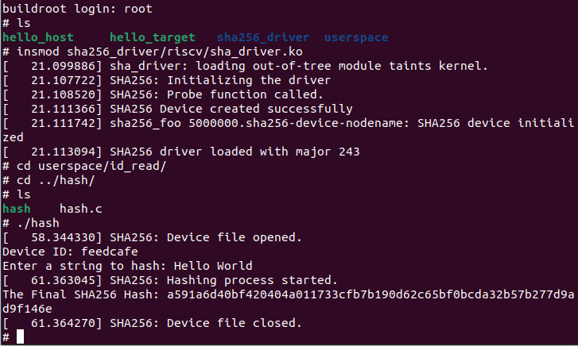
Testing of the Core and Device Driver
User space program was developed to interact with the device driver and cross-compiled.
The core model and device driver were all tested through running the user space program and testing its full functionality.
The final hash was verified and tested against multiple inputs, which yielded correct results.

Slide 11
Cybersecurity Aspects of Cryptography Hardware
Cryptographic hardware is not immune to security risks. Security risks can come from hardware or firmware vulnerabilities.
Side-Channel Attacks are likely, where an attacker gains information by analysing physical outputs, such as Differential Power Analysis (DPA) and Electromagnetic Analysis (EMA).
Hardware Fault Injection Attacks (by voltage spiking or high temperature variations can also lead to loss of sensitive information.
Timing Attacks are also possible where cryptographic operations execution time is analysed to infer sensitive data.
Firmware backdoors, bugs or unsecure APIs can also expose cryptographic hardware to vulnerabilities.

Slide 12
SHA256 Specific Cybersecurity Risks
Length Extension Attacks: If an attacker knows the hash of a secret message and the length of that message, they can calculate a new hash with additional data appended to it, without knowing the original message. This can be problematic in data integrity contexts where the attacker can inject malicious data and no tampering will be detected as the hash matches.
Dictionary Attacks: These attacks involved a precalculated list of hashes corresponding to known inputs that are commonly used.
Quantum Attacks: Quantum computing promises new types of computation algorithms, greatly reducing the search space for brute forcing a hash function. Although theoretically possible, practical quantum computing is far from this, but concerns have led to interest in quantum-resistant cryptographic algorithms.

Slide 13
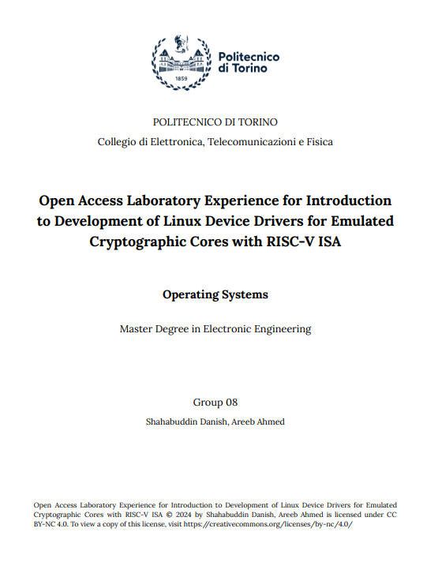
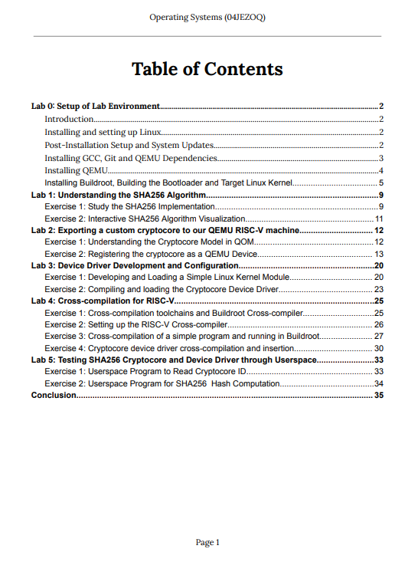
Open Access Laboratory Experience
All material regarding the project was organized and collected in a laboratory experience to explain and teach the project.
Exercises are designed to build understanding, with expected outputs attached as a self-evaluation method.
A step-by-step guide structure is followed in the laboratory experience to utilize the project codebase and replicate results.

Slide 14

The End.
Thank you.
Linux Device Driver Development for SHA256 Cryptographic Core in QEMU for RISC-V ISA © 2024 by Shahabuddin Danish, Areeb Ahmed is licensed under CC BY-NC 4.0. To view a copy of this license, visit https://creativecommons.org/licenses/by-nc/4.0/

